Slide 1


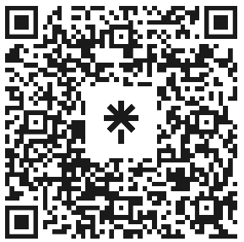

Welcome to Code Crunch!
C8|Crunch Labs: Web Dev
THU 3-4PM Weekly | Spring 2025
Attendance
Earn a Certificate of Completion by attending at least 70% of the workshops
linktr.ee/CODE.CRUNCH

Slide 2
Week #5
Building Interactive Forms with HTML and JavaScript

Slide 3
Introduction to the Week’s Topic
Overview: In this lesson, we will learn how to build forms in HTML, which are essential for gathering user input on web pages. Additionally, we’ll dive into JavaScript event listeners to handle form submissions and validations.
Real-World Relevance:
Forms are central to web applications, from login forms to contact forms, surveys, and e-commerce checkout.
JavaScript allows you to validate and interact with forms before sending the data to the server.

Slide 4
Key Concepts for Today’s Lecture
Concepts Covered:
Building forms in HTML: Inputs, buttons, and form elements.
Event listeners in JavaScript.
Validating form data and handling form submissions with JavaScript.

Slide 5
Introduction to Forms in HTML
What is a Form?
A form is an HTML element that allows users to input data and submit it to the server.
Forms can include various input elements, such as text fields, radio buttons, checkboxes, and buttons.
Form Structure:
The <form> element wraps the input elements.
The action attribute specifies where the form data should be sent, and the method attribute determines how the data is sent (GET or POST).

Slide 6
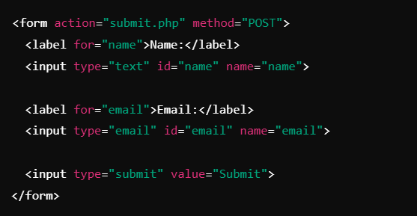

Slide 7
Common Form Input Types
Text Input: <input type="text"> - For single-line text fields.
Email Input: <input type="email"> - For email addresses; browsers provide validation.
Password Input: <input type="password"> - For hiding user passwords.
Radio Buttons: <input type="radio"> - For selecting a single option from a list.
Checkboxes: <input type="checkbox"> - For selecting multiple options.
Submit Button: <input type="submit"> - For submitting the form.

Slide 8
Form Validation in HTML
Built-in HTML5 Validation:
HTML5 introduces attributes for client-side validation such as required, pattern, min, max, and maxlength.
These attributes ensure that users provide valid input before submitting the form.

Slide 9
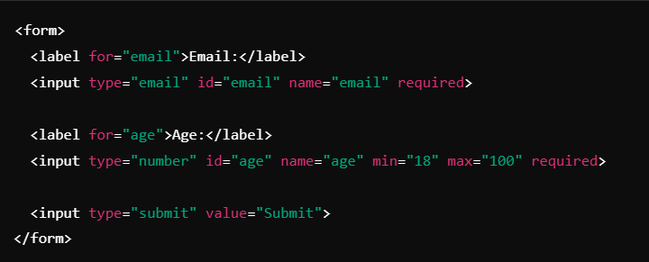

Slide 10
What is an Event Listener?
What is an Event Listener?
An event listener allows JavaScript to respond to user actions (such as clicking a button, submitting a form, etc.).
Common Events:
click: Triggered when an element is clicked.
submit: Triggered when a form is submitted.
input: Triggered when an input field's value changes.
focus: Triggered when an input field gains focus.

Slide 11
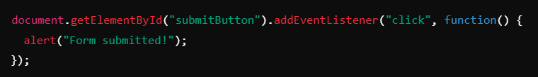
Adding an Event Listener
Use addEventListener() to listen for events on elements.

Slide 12
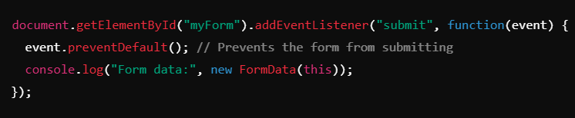
Handling Form Submissions with JavaScript
Preventing Default Form Submission:
By default, when a form is submitted, the page reloads. You can prevent this behavior with JavaScript.

Slide 13
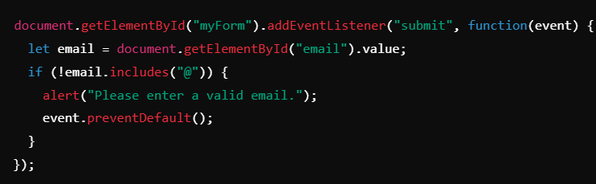
Validating Form Data with JavaScript
Custom Form Validation:
JavaScript allows you to validate form data before submission (e.g., checking if an email address is valid or if a required field is empty).

Slide 14
Summary of Key Points
Forms in HTML: Forms are essential for gathering input from users. Elements like <input>, <textarea>, and <select> are used to capture data.
JavaScript Event Listeners: Event listeners help you handle user interactions and make the webpage dynamic.
Form Validation: Both HTML5 and JavaScript can be used to ensure that form data is valid before submission, preventing errors and enhancing user experience.

Slide 15
Coding Lab

Slide 16
Introduction to the Coding Lab
Objective: In this lab, you will create a basic form and use JavaScript to handle form submissions, validate inputs, and display user feedback.
Skills Covered:
Building a form with various input types.
Adding event listeners to handle form submission.
Using JavaScript for client-side validation.

Slide 17
Setting Up the Development Environment
Step 1: Create a new project folder and an index.html file.
Step 2: Open your project in a code editor like Visual Studio Code.
Step 3: Link a script.js file to your index.html file.

Slide 18
Task 1 - Creating a Simple Form
Objective: Create a simple contact form with fields for name, email, and a message.
Step-by-Step Guide:
Create an HTML form with name, email, and message fields:

Slide 19
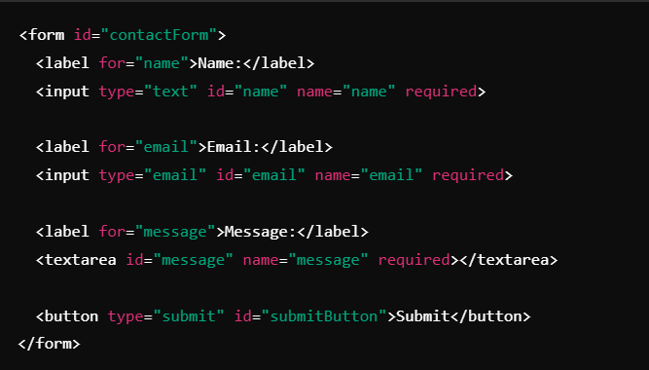

Slide 20
Task 2 - Handling Form Submission
Objective: Prevent the default form submission and log form data to the console when the form is submitted.
Step-by-Step Guide:
In script.js, prevent the form from submitting by using event.preventDefault():

Slide 21
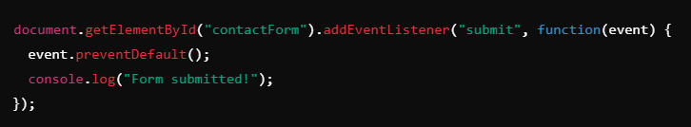

Slide 22
Task 3 - Form Validation
Objective: Validate the form data using JavaScript before submitting.
Step-by-Step Guide:
Check if the email is valid and if the message is not empty.
If any field is invalid, prevent submission and alert the user.

Slide 23
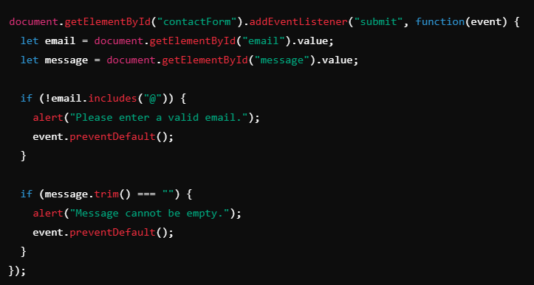

Slide 24
Task 4 - Displaying User Feedback
Objective: After the form is successfully submitted, display a thank-you message instead of submitting the form.
Step-by-Step Guide:
Modify the form submission handler to display a confirmation message:

Slide 25
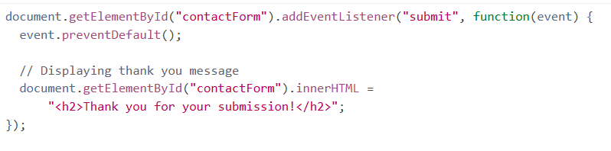

Slide 26
Debugging and Troubleshooting
Common Issues:
Not preventing the default form submission behavior.
Incorrect validation checks (e.g., missing required fields).
Solution: Use the browser's developer tools to troubleshoot and debug issues, checking the Console for error messages.

Slide 27
Code Review
Review the Code: Go through the form code and the JavaScript function step by step.
Discuss the structure of the form.
Ensure that validation and event handling are correctly implemented.

Slide 28
Q & A Session

Slide 29
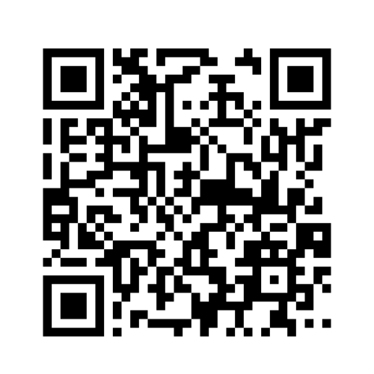
https://github.com/CODE-CRUNCH-CLUB/C8-CRUNCH-LABS-WEB-DEV

Slide 30





Attendance
Join us for the next sessions
Check our schedule on Discord “Schedule” Channel
RSVP lu.ma/CODECRUNCH
Your feedback helps us improve. Share your thoughts! Go to our website: go.fiu.edu/codecrunch
linktr.ee/CODE.CRUNCH

